Slide 1

Align, Incorporate, Deliver Driving Relevant & Impactful Solutions with Scrum Framework-Based Solutions Development & Delivery
Aligning Product Goals With Company Goals while Incorporating the Voice of the Customer, and Ensuring Continuous & Timely Delivery of Simple But Impactful Solutions Driven by Scrum framework-based Software Development
Inspired by the clean & simple goals setting blog article by Ralph Jocham - https://www.scrum.org/resources/blog/deciphering-goals

Slide 2
Company Structure from a Product Lens
Company Vision
Business Strategy
Product Vision
Product Strategy
Value & Solution Discovery
Delivery and Validation

Slide 3
Importance of Each Layer and Its Most Important Documents
Strategic Goal
Vision Statement
Company Vision
Business Strategy
Product Vision
Product Strategy
Value & Solution Discovery
Delivery and Validation
Business Plan
Product Vision
Intermediate Goal
Product Roadmap
Product Goal
Immediate Actionable Goal
Monthly/Bi-weekly Goal
Daily Goal

Slide 4
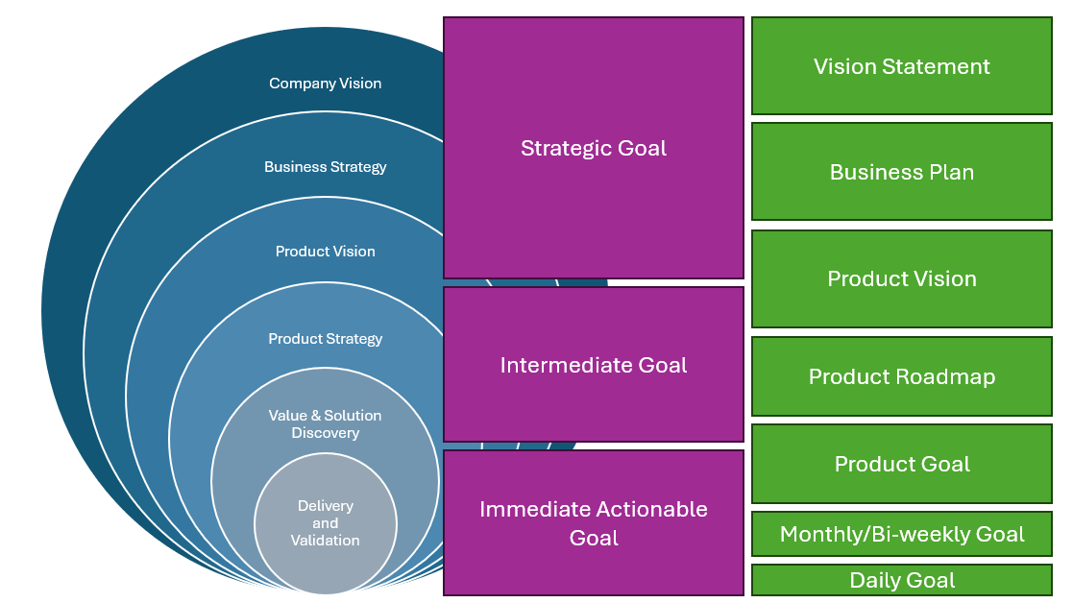
Who drives/own what piece?
Leadership/Management drive this
Product Management
Engineering Manager (in collaboration with the PM)

Slide 5
To Minimize Ambiguity, Here’s How Organizations Should Self-Organize Themselves
Company Vision
Business Strategy
Product Vision
Product Strategy
Value & Solution Discovery
Delivery and Validation
Informs
Informs

Slide 6
Once the Guiding Principles (“North Stars”) Have Been Set, Enact Strategies to Meet Goals
Company Vision
Business Strategy
Product Vision
Product Strategy
Value & Solution Discovery
Delivery and Validation
Enacts
Enacts

Slide 7
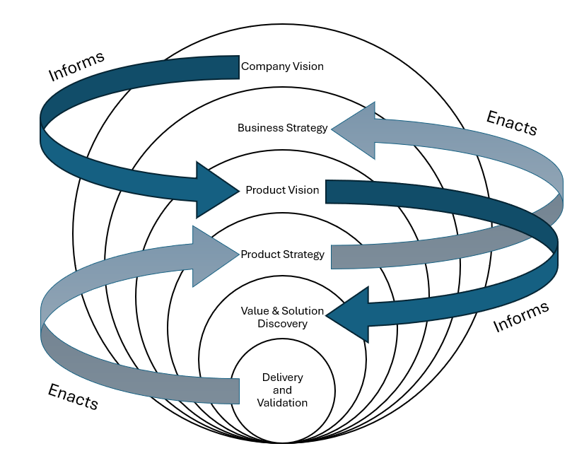
Putting it all together → An Agile organization with growth-systems that enable it to operate like clockwork and ensure that it stays aligned with the market it’s serving
Top-down goal setting initially informs strategy
This helps to get the ball rolling on building appropriate strategies to work towards the goals
The bottom-up enaction of strategies informed by top-down goals allows periodic pulse check of the alignment of goals against the market/voice-of-customers and thus enables realignment as and when necessary
Basically, the ones who are working on delivering at the ground floor are also best suited for giving leadership a reality check on their goals

Slide 8
Let’s now build templates for the following
Vision Statement
Business Plan
Product Vision
Product Roadmap
Product Goal
Monthly/Bi-weekly Goal
Sprint & Daily Goal will be defined later, in the subsequent section on Scrum-driven Software Development
Daily Goal

Slide 9
Defining the Company’s Mission & Vision
Chances are that the company you’re working for has already formulated its mission & vision.
Maybe the leadership hasn’t finalized these or is looking to modify them to align better with the market.
Or perhaps the company is looking to pivot altogether and needs to formulate its mission/vision from scratch.
My go-to resource: Product Roadmaps Relaunched by C. Todd Lombardo et al. https://www.amazon.com/Product-Roadmaps-Relaunched-Direction-Uncertainty/dp/149197172X

Slide 10

Vision Statement
When it’s all said and done and your company has achieved (for the planet) what it set out to achieve (a wishful future state of the planet & the company), WHAT is that future state?
A lot of companies conflate vision (future state) with mission (how we get there)
The future state you want to achieve is essentially set in stone. That will ideally never change. HOW you get there may be subject to change (ideally never, but it could).
Two main elements:
Who is/are the target customers?
What benefit(s) were addressed/achieved?
Examples – organizations in cleantech are broadly trying to achieve a decarbonized future for everyone (the entire planet). Their Vision statements could look like the following:
A clean energy future for all (NREL’s vision)
To electrify the world with renewable energy (Mainstream Renewable Power)

Slide 11

Mission Statement
It is not what you value, nor is it a vision for the future
Mission is what drives you right now (purpose) to give it all you’ve got to realize your company’s Vision
Keep the mission statement 1-2 sentences long, and include the following 4 elements:
Value – what value do your actions (mission) add?
Inspiration – is it inspirational for your team (the ones who’ll help achieve the vision)
Plausibility – Is the mission realistic & achievable? Okay to be ambitious, but not overly-ambitious
Specificity – Keep it relevant to the business and the industry you’re serving
Examples – same two organizations from the previous slide explaining HOW they’re going to achieve their Vision:
Leading research, innovation, and strategic partnerships to deliver solutions for a clean energy economy
A clear highlight of ways they’re going to achieve their vision.
Our mission is to lead this transition (Mainstream Renewable Power)
As an employee, I now know that my company wants to power the world with renewable energy, and it wants to be the one leading this effort. Great! I’ll make sure to give it my all because I agree that we need to decarbonize fast, and my company wants to give it its all. We’re aligned on this, and we’re all in this together and we’re going to make it happen!

Slide 12
Company Value Proposition (Elevator Pitch) Template
FOR <insert ideal customer profile>
WHO <main customer pain points >
THE <company>
IS A <what is the company? What is its solution? Why does it exist>
THAT <value proposition in SMART terms> ----below two pointers are optional---
UNLIKE <status quo; how things are currently done>
OUR <value proposition in qualitative terms>

Slide 13
Company Vision Statement - Example
Imagine a landscaping company – Wombat – that sells one product and one product only – a garden hose:
FOR homeowner landscape enthusiasts
WHO need a reliable hose that can survive repeated use
THE Wombat Garden Hose
IS A water delivery system
THAT offers a reliable operation under any conditions
UNLIKE the competition
OUR Wombat Garden Hose is indestructible and offers uninterrupted water delivery

Slide 14
Company Vision Statement - Example
Same company and product as before, but a slight tweak → the value proposition quantifies the benefit of using the product. Great way to show your product’s quality is based on facts and that your organization is data-driven.
FOR homeowner landscape enthusiasts
WHO need a reliable hose that can survive repeated use
THE Wombat Garden Hose
IS A water delivery system
THAT lasts 7-years longer than the average garden hose in the market today

Slide 15
Business Plan/Strategy Canvas - Template
Problem Statement
Top 1-5 problems faced by customers
Solution Set
Possible solution to each problem
Value Proposition
How/why <Company> is different and/or worth paying attention to
Hard-to-Replicate Advantages
What sets <Company> apart from the competition and creates barriers to entry
Customer Segments
List the ideal customer profiles
Existing Alternatives
How current pain points are addressed today
Key Metrics
KPIs to measure health of your business
High-Level Concept
What’s our X for Y analogy? E.g.: YouTube is Flickr for videos
Channels
How do we provide solutions to our customers? (E.g.: phone app, web browser, etc.)
Early Adopters
Top identifying characteristics of the tech enthusiasts
Cost Structure
List fixed & variable costs
Revenue Streams
List sources of revenue

Slide 16
Product Value Proposition (Elevator Pitch) Template
FOR <insert ideal customer profile>
WHO <main customer pain points >
THE <product>
IS A <what is the product?>
THAT <value proposition in SMART terms> ----below two pointers are optional---
UNLIKE <status quo; how things are currently done>
OUR <value proposition in qualitative terms>

Slide 17
Product Roadmapping
You’re a [software] Product Manager. Not a Project Manager.
Avoid Gantt chart style communication of product plans → Ones that contain specific deliverables and sub-deliverables and exact timelines/deadlines
They appease middle- and upper-management and in the moment, they provide a sense of comfort that everything’s been well planned and thoroughly considered
But! Anything hardly ever goes according to plan or sticks to timeline
Agile/Scrum framework was developed to overcome & embrace uncertainty. Roadmaps for Scrum-driven teams therefore look much different.

Slide 18
Product Roadmap – High Level Capturing of Goals
Now (Keep it high level-ish. Perhaps Q1, or H1) | Next (Q2) | Later (H2 or Year 2)
Bulleted list of Themes: These are key problems customers face (firstly), key company initiatives (secondary) Bulleted list of Business Objectives: (e.g.: increase sales, reduce churn, increase CSAT, etc.)

Slide 19
Let’s now build Monthly & Daily Goals
Vision Statement
Business Plan
Product Vision
Product Roadmap
Product Goal
Monthly/Bi-weekly Goal
Daily Goal

Slide 20
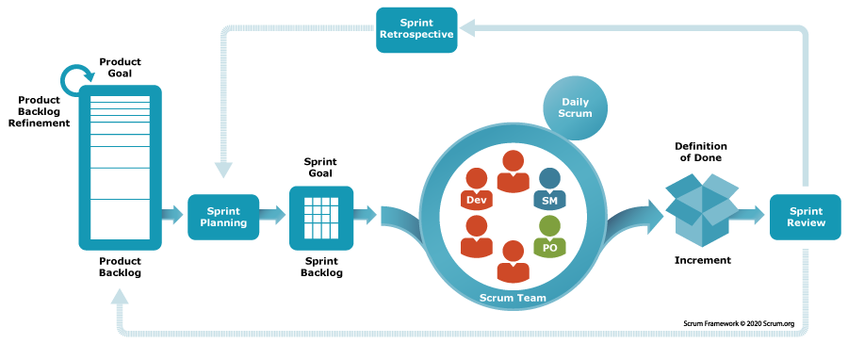
How does a Product Manager Orchestrate Delivery of Immediate Goals? Scrum!
Immediate Actionable Goal
?
Monthly/Bi-weekly Goal
Daily Goal
Scrum

Slide 22
What is Scrum?
Better Scrum.org explain it than me - https://www.scrum.org/resources/what-scrum-module
Exec Summary: Think of Scrum as a way to get work done as a team in small pieces at a time, with continuous experimentation and feedback loops along the way to learn and improve as you go. Scrum helps people and teams deliver value incrementally in a collaborative way. It’s a framework, not a methodology (recipe). Scrum provides just enough structure for people and teams to integrate into how they work, while adding the right practices to optimize for their specific needs.

